Slide 1


Kostadin Slavov
Jan 10, 2024

Slide 2

Outline
Executive Summary
Introduction
Methodology
Results
Conclusion
Appendix

Slide 3
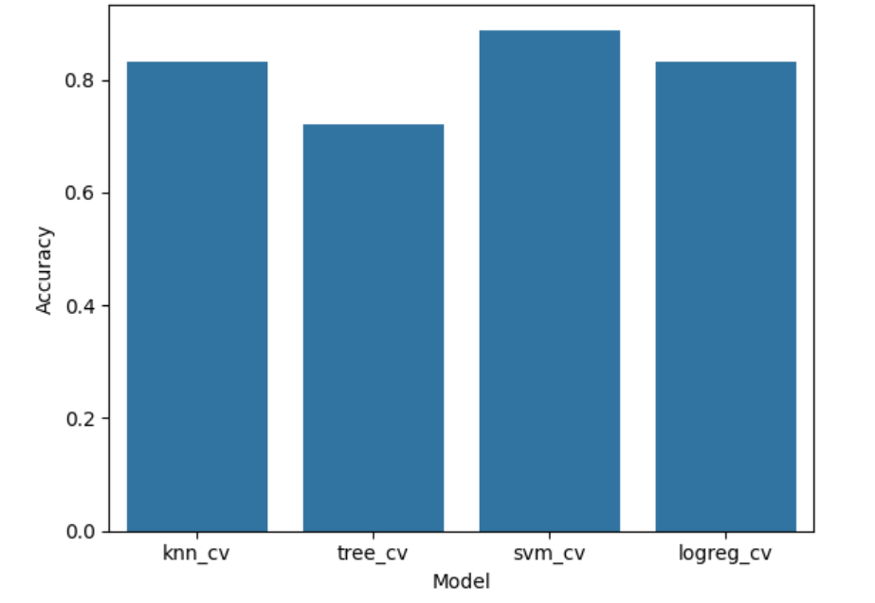
Executive Summary
Summary of methodologies
We have used several techniques to address the problem and to predict whether or not a SpaceX rocket will land successfully or not.
Summary of all results
Currently we can say with confidence of 83% that out support vector machine can predict whether the rocket will land successfully based on several parameters

Slide 4
Introduction
The goal of our company is to find pattern in the mistakes of our competitor SpaceX, in order to prevent the failure of our rockets.
The problems we want to find answers to are the following.
Which are the important parameters of the flight affecting the success rate.

Slide 5

Section 1

Slide 6
Methodology
Executive Summary
Data collection methodology:
The data was collected from the official SpaceX API
Perform data wrangling
Add a binary column class based on the Landing Outcome
Perform exploratory data analysis (EDA) using visualization and SQL
Perform interactive visual analytics using Folium and Plotly Dash
Perform predictive analysis using classification models
Standardize the data, split in training and test set, find the method that fits best for data predictions.

Slide 7
Data Collection
We have used several sources of information
The spaceX api
Wikipedia

Slide 8
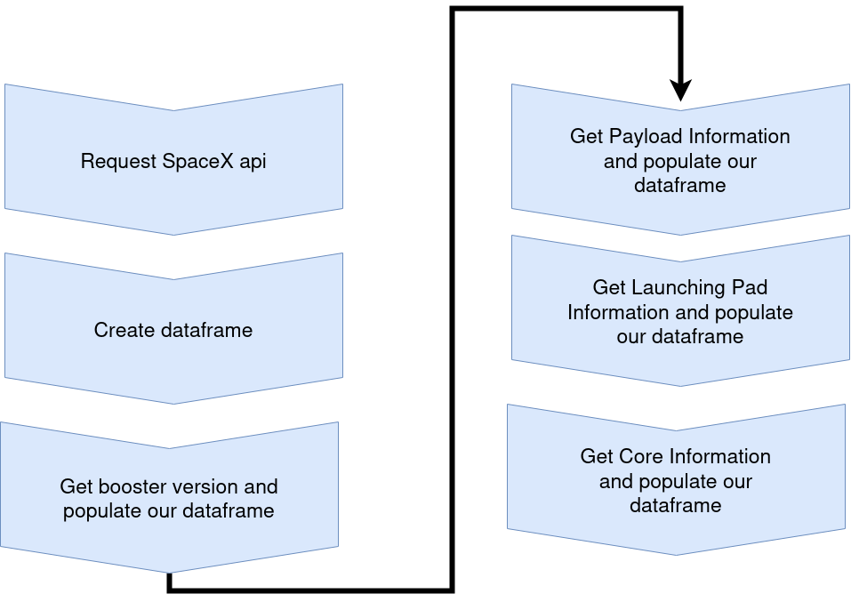
Data Collection – SpaceX API
Collect the data from official spaceX API.
Get the Falcon 9 only data.
Fill the missing values with mean in the PayloadMass column.
Save the data.
Jupyter notebook for reference

Slide 9
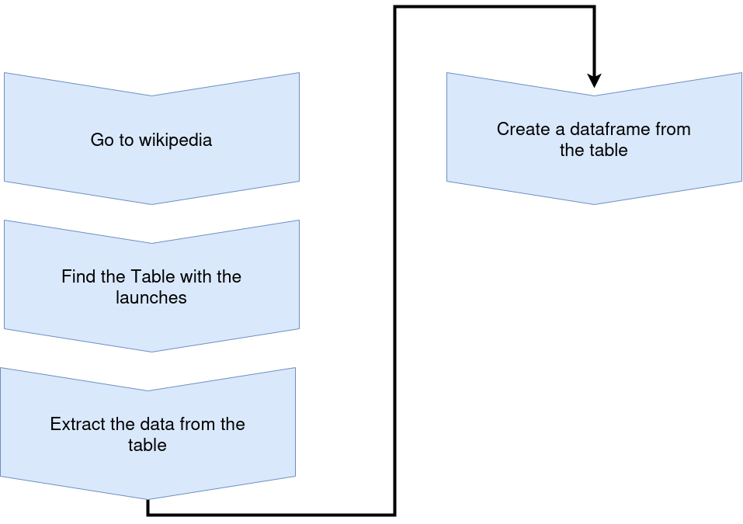
Data Collection - Scraping
Find the data on Wikipedia
Collect the data with web-scraping techniques
Create a dataframe.
Jupyter notebook for reference

Slide 10
Data Wrangling
Analyze the data. Get to know and understand the data types, and calculate the following:
Numbers of launches on each site
Calculate the number and occurrences of each orbit
Calculate the number and outcome of each orbit
Create a binary class column for success and failure.
Jypyter notebook for reference

Slide 11
EDA with Data Visualization
Create different plots in order to observe if there is a pattern to be followed.
PayloadMass vs FlightNumber
LaunchSite vs FlightNumber
PayloadMass vs LaunchSite
Orbit vs Class
Orbit vs FlightNumber
PayloadMass vs Orbit
Date vs Class
Jupyter notebook for reference

Slide 12
EDA with SQL
Performed sql queries:
Get all of the LaunchSite
Get launches from LaunchSite starting with “CCA”
Get all of the launches where customer is NASA
Compute the average Payload Mass for Falcon 9
Get all of the Landing Outcomes
Select the first Successful landing outcome
Select All of the booster versions
Count all of the Successful and Failed mission outcomes
Get all of the boosters which carried the maximum payload
Get all of the failures in 2015
Get the landing outcomes for Failure (drone ship)/Success(ground pad) for a range of time
Jupyter Notebook for reference

Slide 13
Build an Interactive Map with Folium
The map includes several objects in order to visually represent the launching areas and their environments:
Circle and marker for the NASA center
Clusters of markers for each launching pad
Distance between launching pad and a key point (Coast line, RailWay Highway)
Jupyter notebook for reference

Slide 14
Build a Dashboard with Plotly Dash
In the plotty dash we have added:
Launch Site select
Pie chart with success/failure ratio
Payload slider
It is very interactive way to plot data based on launchpad and payload mass.
Project reference in GitHub

Slide 15
Predictive Analysis (Classification)
Performed actions during the Predictive Analysis
Load the data and the transformed data
Transform the parameters for the prediction (X data)
Define the Y data and export it to numpy array
Split the data in test and train with test size 0.2
Perform the following classifications with features engineering in order to find the best model tuned with GridSearchCV
K-nearest neighbour
Decision Tree
Support Vector Machine
Logical Regression
Create a confusion matrix as a result
Compute the score of the models and their best parameters\
Find the best fit model

Slide 16
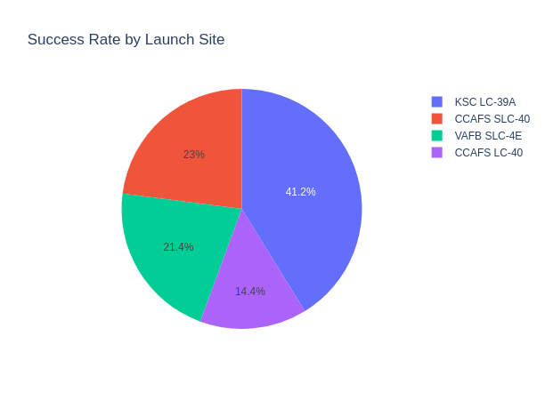
Results
We have come to conclusion that the different launching sites have different success rate.
Some launching sites do not send massive payloads.
Some of the orbits have great success rate than the others.
Our most successful model was the SMV.

Slide 17

Section 2

Slide 18
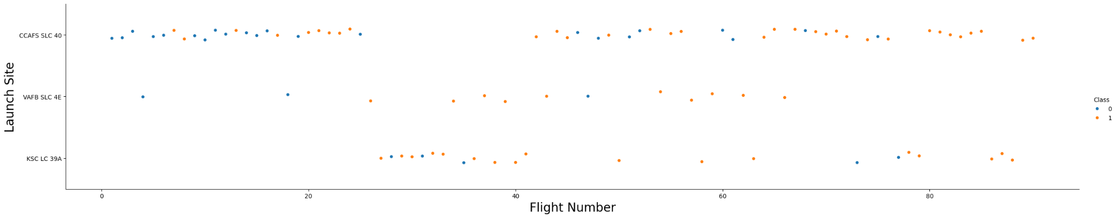
Flight Number vs. Launch Site
From this chart we understand that further in time the success rate improves which means that the company is taking care of the problems met during the failed ones.
Also VAFB SLC 4E has very low failure rate

Slide 19
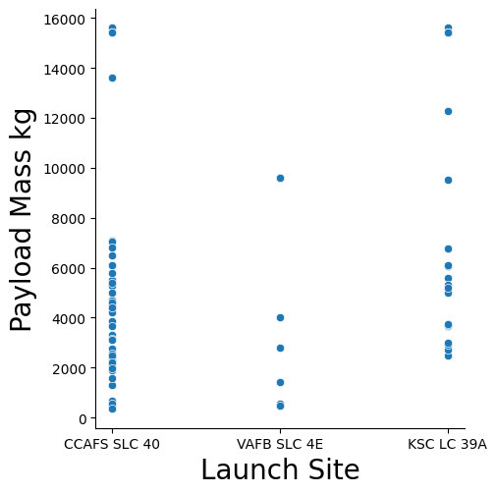
Payload vs. Launch Site
VAFB SLC 4E never sent a payload larger than 10000kg. Which is why the success rate is so high.
KSC LC 39A never sent a payload lighter than 3000kg.

Slide 20
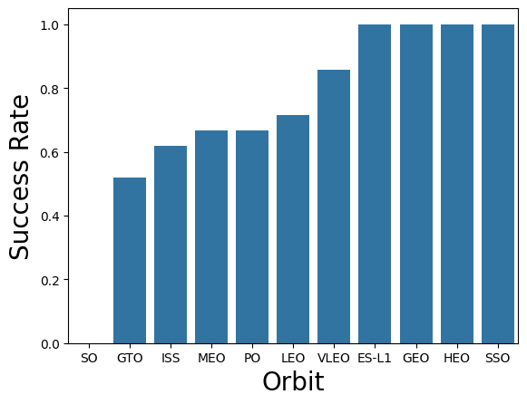
Success Rate vs. Orbit Type
We see that some of the orbits are dominating
SO has success rate of 0

Slide 21
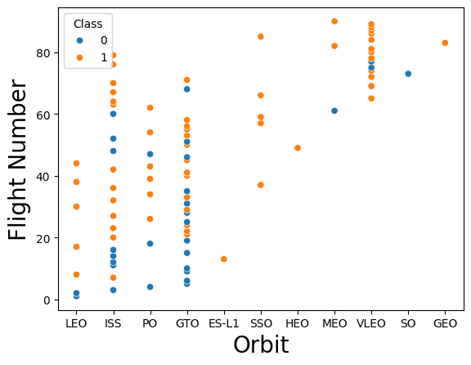
Flight Number vs. Orbit Type
With the flight number there is a positive trend for reaching higher orbits.
There is no weight of flight number to the higher obits because there is not enough data for the higher orbits yet.

Slide 22
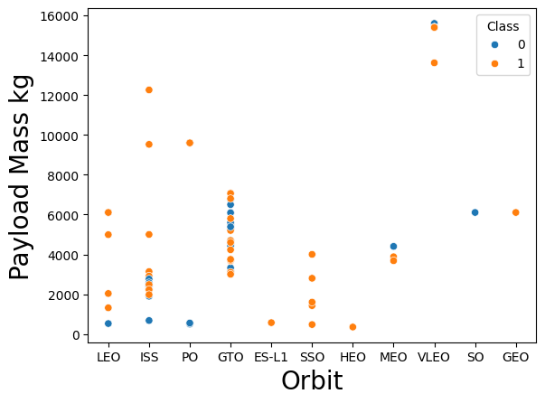
Payload vs. Orbit Type
There is only heavy payloads sent to the VLEO and 6000kg to SO and GEO.
Most of the reached/attempted orbits are between 1000kg and 8000kg
SSO has 100% of success rate

Slide 23
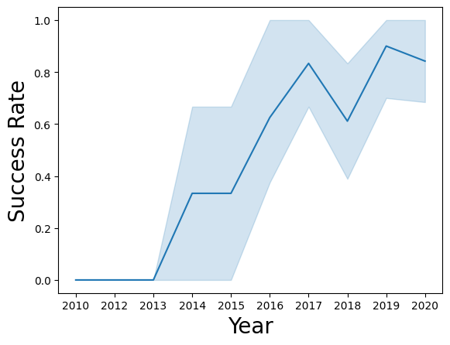
Launch Success Yearly Trend
The success rate is increasing positively from 2013 until 2020 with a little low in 2018.

Slide 24
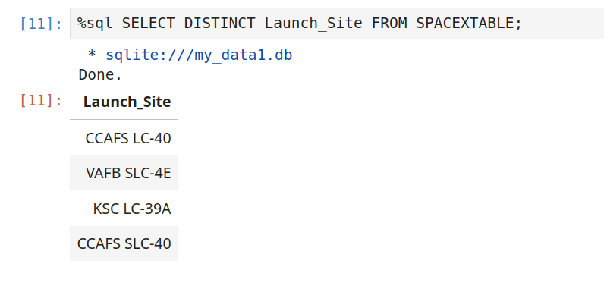
All Launch Site Names
We use the DISTINCT
Keyword to get all of the
values in Launch_Site
column.

Slide 25
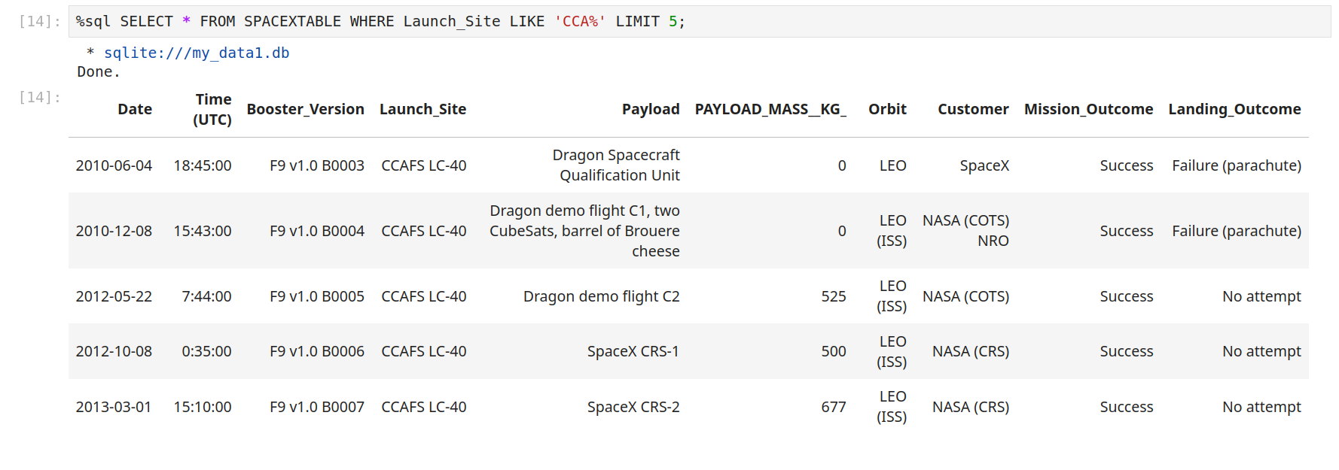
Launch Site Names Begin with 'CCA'
We use the LIKE keyword to find them.

Slide 26
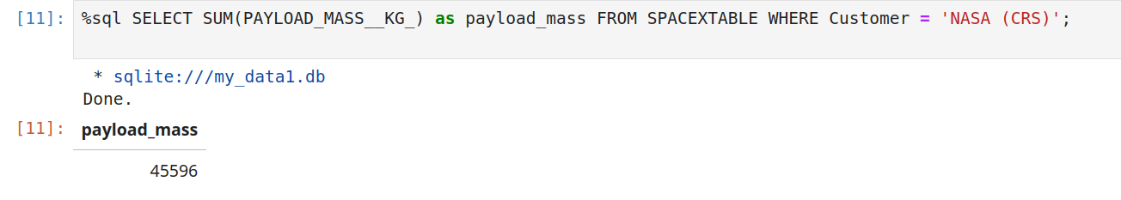
Total Payload Mass
We use the SUM keyword to sum the column PAYLOAD_MASS__KG_

Slide 27
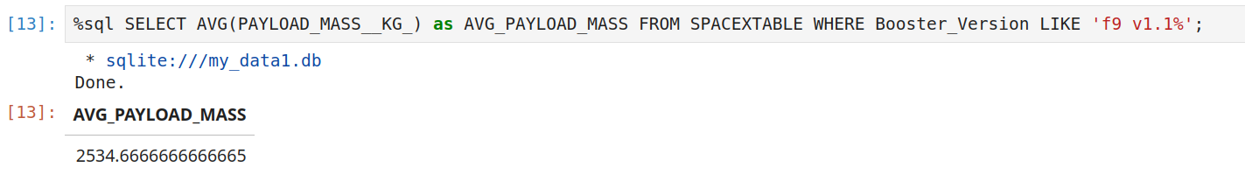
Average Payload Mass by F9 v1.1
We use the AVG keyword and LIKE, because there are several subversions of the Falcon 9v.1.1%

Slide 28
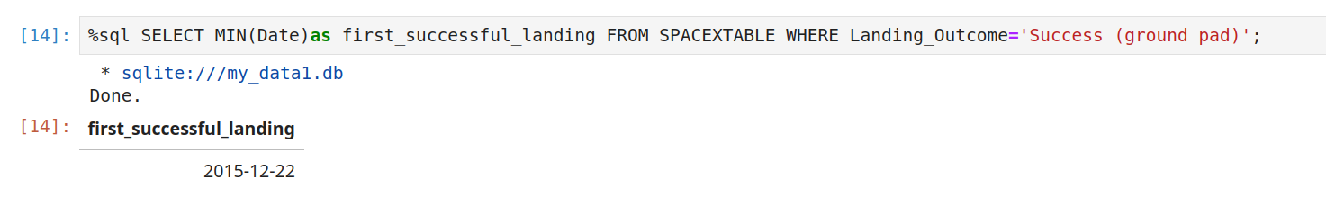
First Successful Ground Landing Date
Use the MIN keyword on the Date column to find the first successful ground landing date.

Slide 29
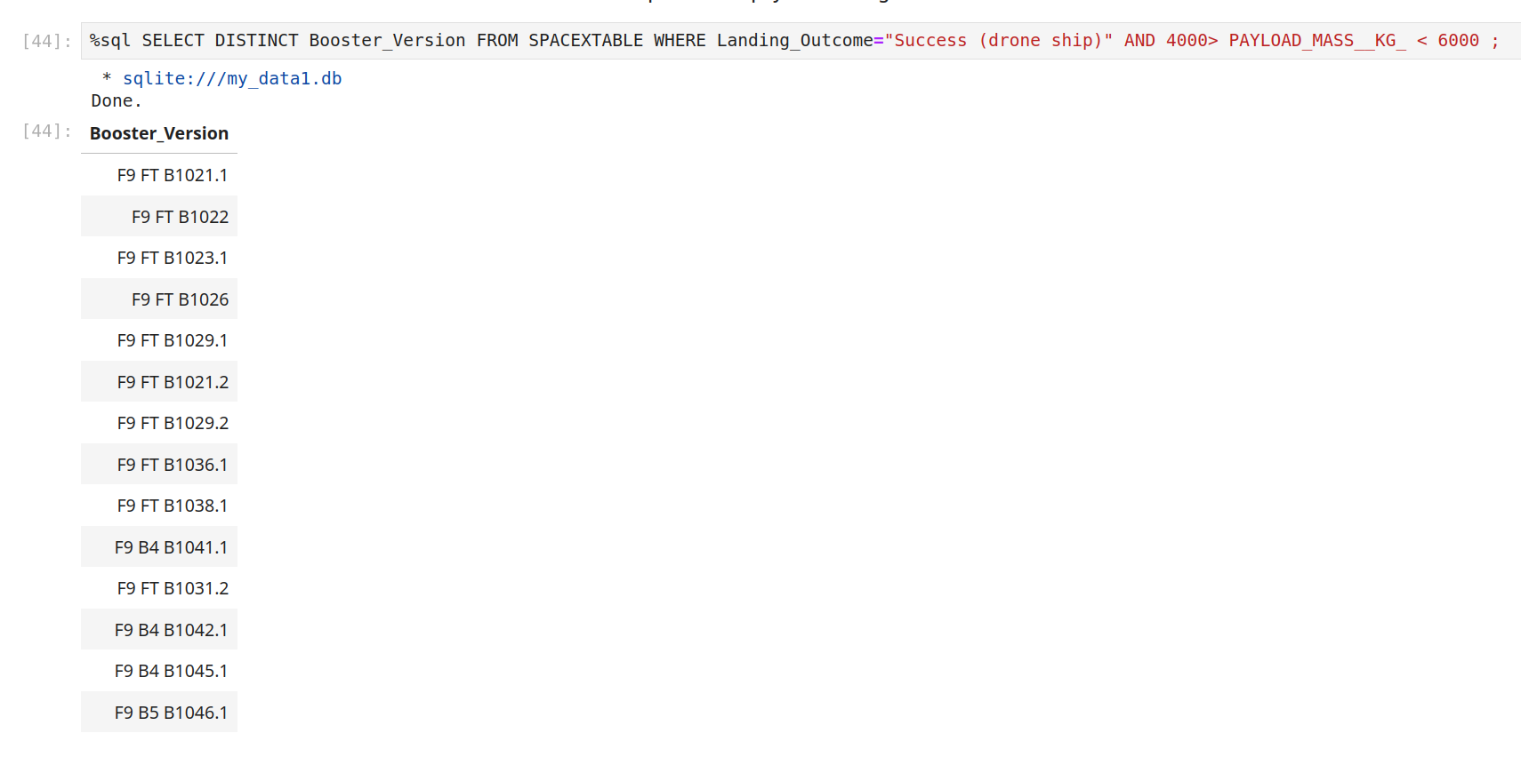
Successful Drone Ship Landing with Payload between 4000 and 6000
Use the range query and the distinct keyword to find all of the booster versions.

Slide 30
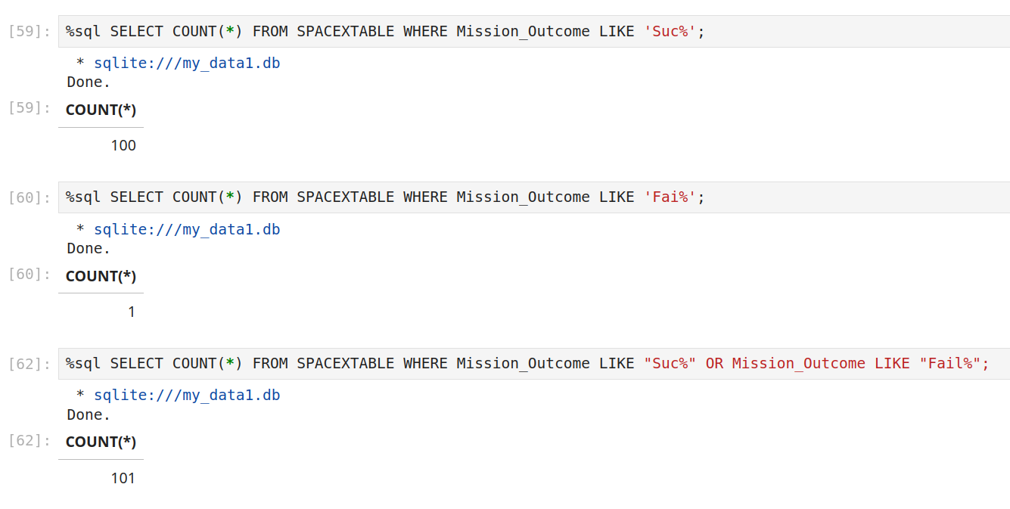
Total Number of Successful and Failure Mission Outcomes
Use the COUNT keyword. We have observed that there is only one failed mission.

Slide 31
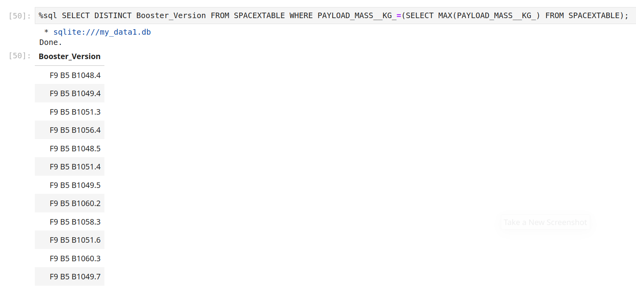
Boosters Carried Maximum Payload
Use subquery to find the max value of the payload mass, in order to perform the query.

Slide 32
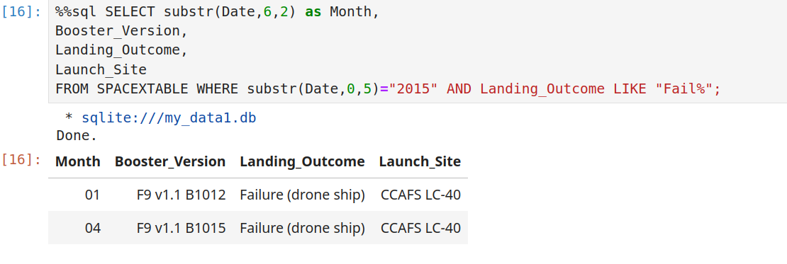
2015 Launch Records
Use substr as sqlite does not support filtering by Date.

Slide 33
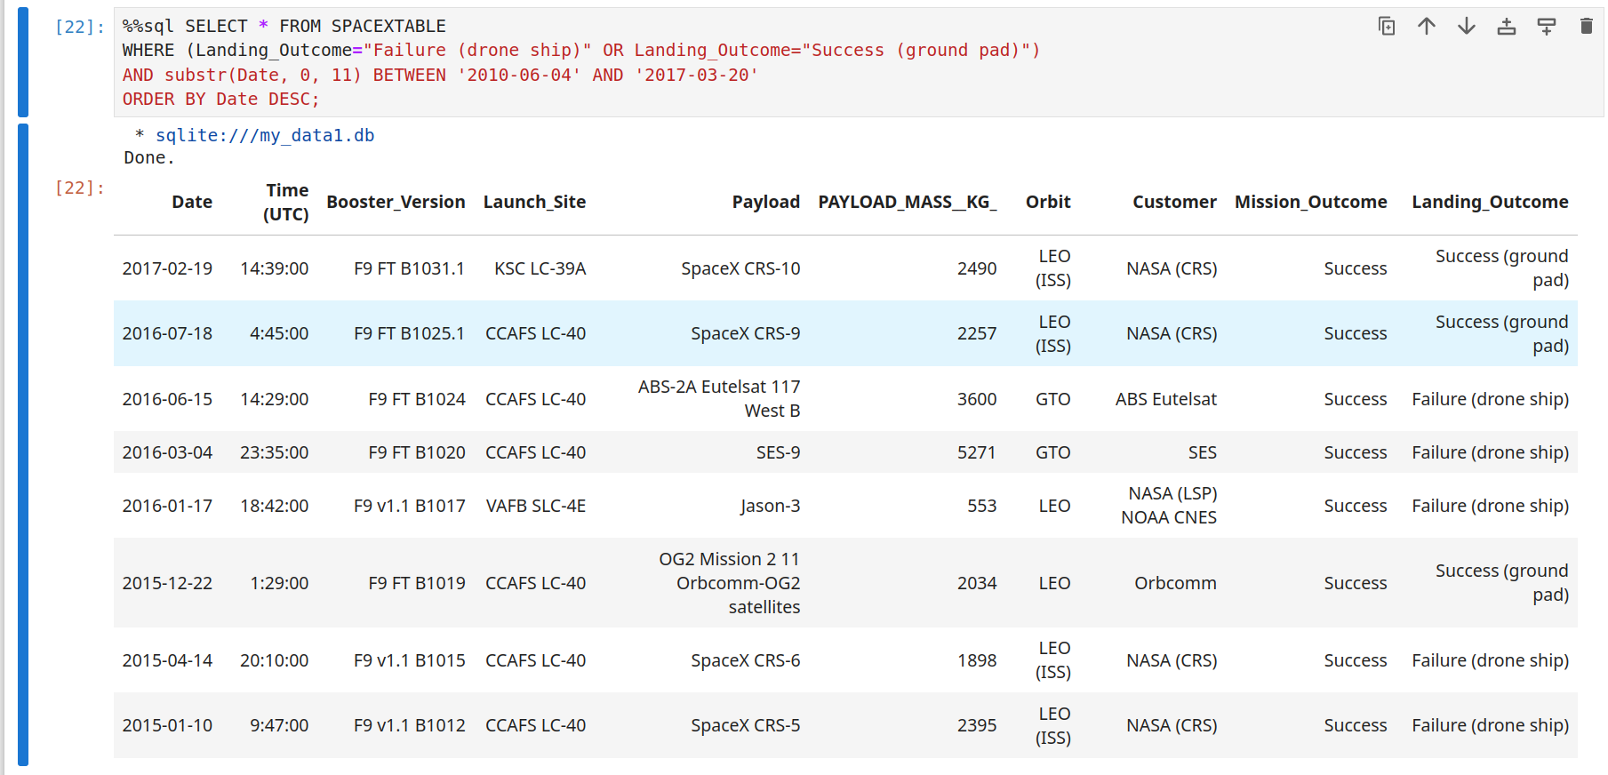
Rank Landing Outcomes Between 2010-06-04 and 2017-03-20
We use again the substr for Date range and the BETWEEN keyword. Then we Order the results in descending order by Date.

Slide 34

Section 3

Slide 35
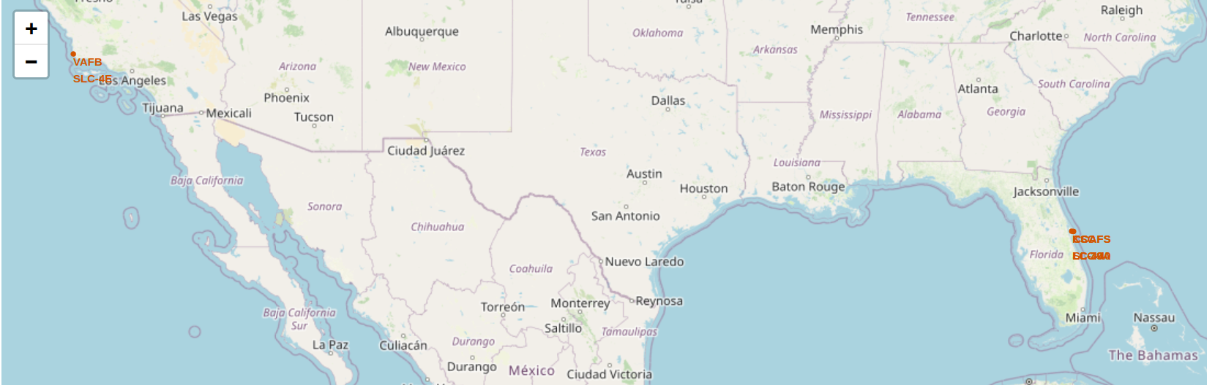
Launch Location sites
We can see that the launch location sites are very close to the East and West coast lines.

Slide 36
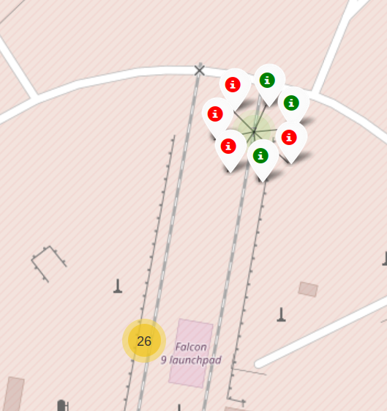
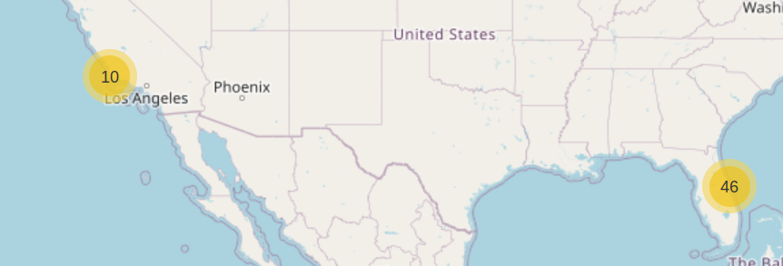
Clusters and success/failure markers
We can see that there is 46 launches from the East coast
and 10 from the West coast.
Also we have added success/failure markers on
the location.

Slide 37
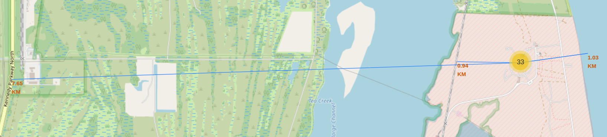
Nearby Keypoints
In proximity of the launchpad there are:
Coast line (1.3km)
Railway (0.94km)
Highway (7.65km)

Slide 38

Section 4

Slide 39
Interactive Dashboard Landing Success rate
KSC LC-39A is dominating with
success rate of 41.2%.
CCAFS LC-40 is doing very low
percent wise.

Slide 40
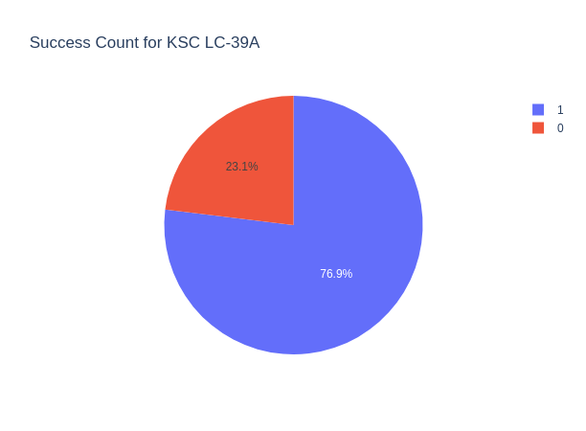
Success Rate for KSC LC-39A
Only 23.1% of the missions have
failed landing. 76.9% Success Rate

Slide 41
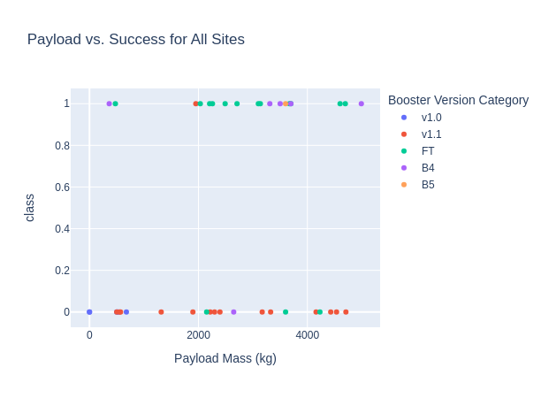
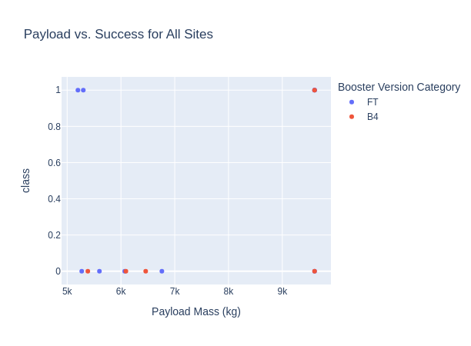
Light vs Heavy payloads
Up to 5000 kg
Most of the boosters carry under 5000 kg with a mixed percentage of success rate
Over 5000 kg
Fewer of the boosters carry over 5000 kg and the success rate drastically drops

Slide 42

Section 5

Slide 43
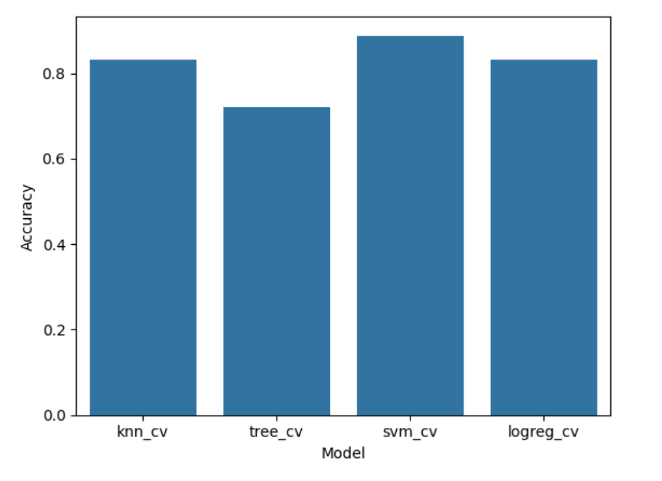
Classification Accuracy
The model with highest accuracy is the Support Vector Machine with accuracy : 0.8482142857142856
best parameters { 'C': 1.0, 'gamma': 0.03162277660168379, 'kernel': 'sigmoid' }

Slide 44
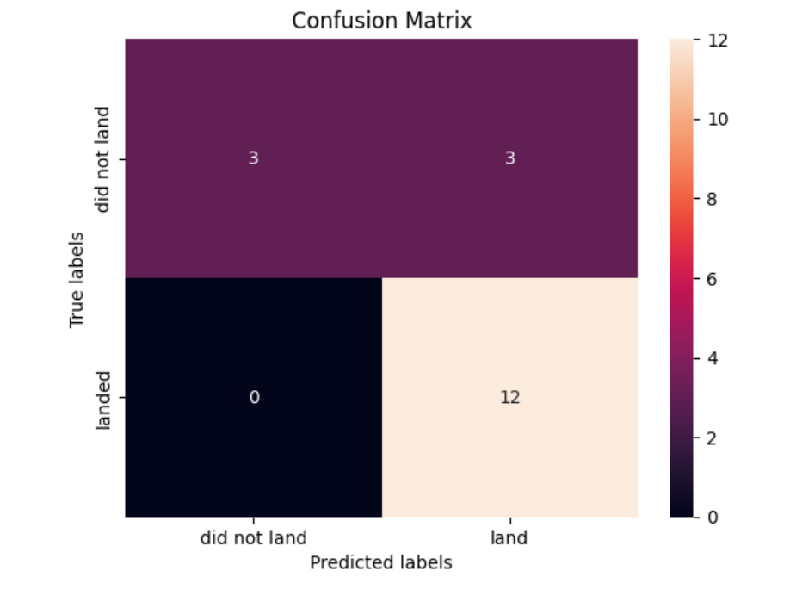
Confusion Matrix
The model predicted correctly all
of the landed cases, but it needs
improvement with distinguishing
certain negative cases.

Slide 45
Conclusions
The success rate falls when the payload weight increases.
ES-L1, GEO, HEO, SSO has the higher orbit success rate.
Since 2015 the success rate is in positive trend.
Each of the launch pads is close to the seashore, railway and highway.
KCS-LC 39-A has the higher success.
The average payload size is 2534kg.
VAFB SLC 4E never sent a payload larger than 10000kg.
KSC LC 39A never sent a payload lighter than 3000kg.
Support Vector Machine is the best prediction model with confidence of 83%.

Slide 46
Appendix
All of the work can be found at GitHub.

Slide 47


